Slide 1




Logic Building
,
Dry Run Techniques,
& Flagged While Loops
Programming Fundamentals
Building Blocks for Efficient Code
Presented by
Khurram Iqbal
Department of Computer Science

Slide 2








Introduction to
Logic Building
What is Logic Building?
The Logic Building Process
Logic building is the process of developing step-by-step solutions to problems through structured thinking and reasoning.
1
Understand the Problem
Clearly define inputs, outputs, and constraints
The foundation of programming that transforms ideas into executable code
2
Break Down the Problem
Divide into smaller, manageable sub-problems
It involves breaking down complex problems into smaller, manageable parts and creating a systematic approach to solve them.
3
Develop Algorithm
Create step-by-step solution approach
Why is it Important?
4
Implement Solution
Foundation for all programming tasks
Translate algorithm into code
Enables efficient problem-solving
Improves code quality and maintainability
5
Test and Refine
Essential for technical interviews
Verify solution and optimize if needed
Key Skills Developed
Analytical Thinking
Pattern Recognition
Problem Decomposition
Algorithmic Thinking
"Programming is not about typing, it's about thinking." —
Linus Torvalds

Slide 3



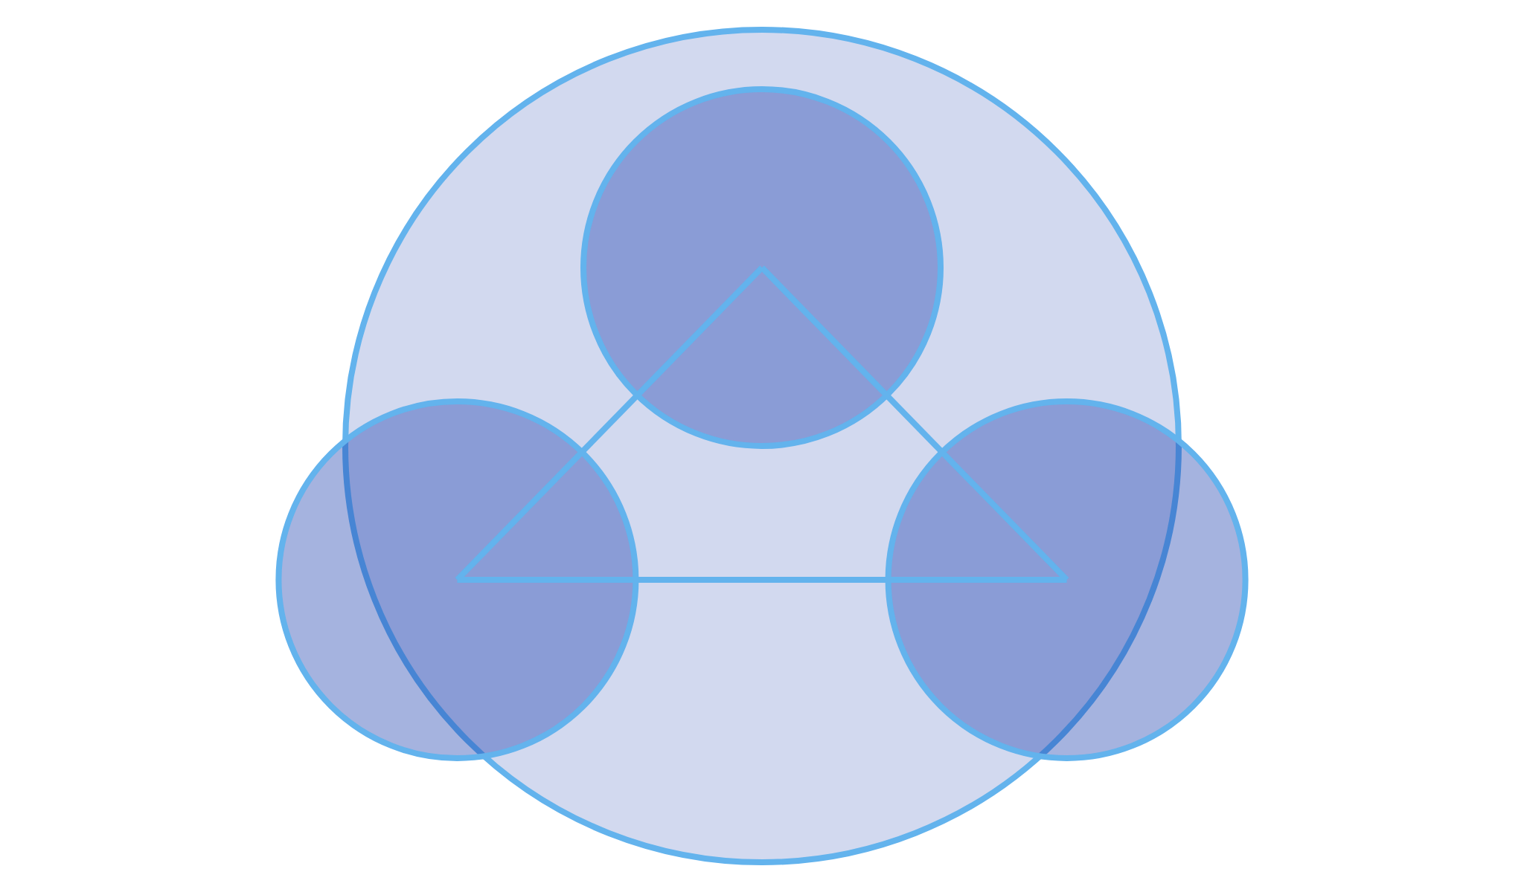


Components of
Logic Building
Core Components
Implementation Components
Problem Understanding
Algorithm Development
Thoroughly analyzing the problem statement to identify:
Creating a step-by-step procedure to solve the problem:
• Required inputs and expected outputs
• Defining logical sequence of operations
• Constraints and edge cases
• Establishing control flow (conditionals, loops)
• Performance requirements
• Determining data structures and operations
• Available resources and limitations
• Ensuring correctness and efficiency
Problem Decomposition
Solution Representation
Breaking down complex problems into smaller, manageable sub-problems:
Expressing the solution in a clear, understandable format:
• Identifying independent components
• Pseudocode or flowcharts
• Establishing relationships between components
• Programming language constructs
• Creating a hierarchical structure
• Data structure selection
• Applying divide-and-conquer approach
• Function and module organization
Pattern Recognition
Verification & Optimization
Identifying familiar patterns that can be applied to solve the problem:
Testing and improving the solution:
• Recognizing common algorithmic patterns
• Validating correctness with test cases
• Applying previously solved solutions
• Handling edge cases and exceptions
• Adapting existing patterns to new contexts
• Analyzing time and space complexity
• Leveraging design patterns when appropriate
• Refining for better performance
Thinking Approaches
Component Integration
Linear Thinking
Lateral Thinking
Step-by-step sequential approach to problem-solving
Creative approach exploring multiple solution paths
Problem Analysis
Analytical Thinking
Adaptive Thinking
Breaking down complex systems into components
Adjusting approach based on feedback and results
Logic Building
Algorithm Design
Implementation
Effective logic building integrates all components into a cohesive problem-solving approach

Slide 4


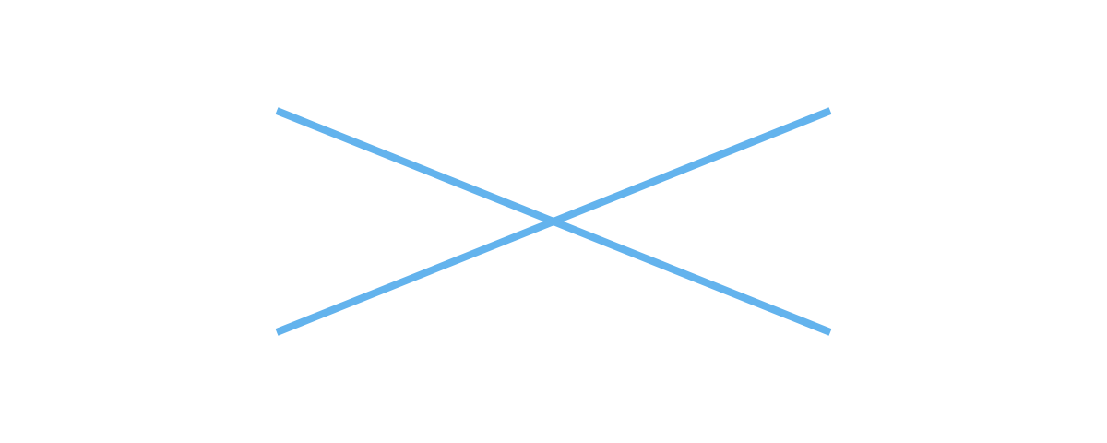





Logic Building
Techniques
Visual Techniques
Methodological Techniques
Flowcharts
Stepwise Refinement
Visual representation of algorithm using standardized symbols:
Breaking down a problem into increasingly detailed steps:
Start
Level 1: High-level goal
Sort the array
Level 2: Main steps
1. Divide array in half
Input
2. Sort each half
3. Merge sorted halves
Level 3: Detailed implementation
Process
1.1 Find middle index
1.2 Create subarrays
...
Decision
Benefits: Manages complexity, provides clear structure, systematic approach
End
Test-Driven Development
Writing tests before implementing solution:
Benefits: Visual clarity, standardized notation, easy to follow
1
Write test for specific functionality
Mind Maps
2
Run test (it will fail)
Hierarchical diagram connecting related concepts:
3
Write minimal code to pass test
Sub-problem 1
Sub-problem 3
4
Refactor code while keeping tests passing
Main Problem
Benefits: Clarifies requirements, ensures correctness, builds confidence
Sub-problem 2
Sub-problem 4
Benefits: Visualizes relationships, aids brainstorming, organizes thoughts
Problem-Solving Strategies
Pattern Recognition
Divide & Conquer
Textual Techniques
Identifying familiar patterns in problems and applying known solutions
Breaking problem into smaller, independent subproblems
Pseudocode
Abstraction
Analogy
Human-readable description of algorithm using code-like syntax:
Focusing on essential aspects while ignoring irrelevant details
Applying solutions from similar problems to current problem
function
findMax(array):
max = array[0]
for
i = 1 to array.length - 1:
Working Backwards
Trial & Error
if
array[i] > max:
Starting from the goal and determining steps to reach it
Systematically trying different approaches and learning from results
max = array[i]
return
max
Benefits: Language-independent, focuses on logic, easy transition to code
Effective logic building often combines multiple techniques based on the specific problem requirements and constraints.
Comments & Documentation
Detailed written explanations of logic and approach:
// Function to find maximum value in array
// Input: Array of numbers
// Output: Maximum value in the array
// Time Complexity: O(n) where n is array length
function
findMax(array) {
// Initialize max with first element
...
}
Benefits: Clarifies thinking, documents approach, helps with debugging

Slide 5


Logic Building
Examples
Example 1: Finding Maximum Value
Example 2: Binary Search
Problem Statement
Problem Statement
Find the maximum value in an array of integers.
Search for a target value in a sorted array efficiently.
Logic Building Process
Logic Building Process
1. Understand the problem: Find largest number in a list
1. Understand the problem: Find value in sorted array
2. Identify inputs/outputs: Input is array, output is single integer
2. Identify pattern: Divide and conquer approach
3. Develop algorithm: Compare each element with current maximum
3. Develop algorithm: Compare target with middle element, narrow search range
4. Handle edge cases: Empty array, negative numbers
4. Handle edge cases: Target not found, empty array
Implementation
Implementation
// Function to find maximum value in array
function
findMax(array) {
// Binary search implementation
// Handle edge case
function
binarySearch(array, target) {
if
(array.length === 0) {
let
left = 0;
return
null;
let
right = array.length - 1;
}
while
(left <= right) {
// Initialize max with first element
// Find middle index
let
max = array[0];
let
mid = Math.floor((left + right) / 2);
// Compare each element with current max
// Check if target is found
for
(
let
i = 1; i < array.length; i++) {
if
(array[mid] === target) {
if
(array[i] > max) {
return
mid;
max = array[i];
}
}
}
// Narrow search range
if
(array[mid] < target) {
return
max;
left = mid + 1;
}
}
else
{
right = mid - 1;
}
}
// Target not found
return
-1;
}
Example 3: Palindrome Check
Problem Statement
Logic Building Process
Implementation
Check if a string is a palindrome (reads the same forward and backward).
1. Understand the problem: Compare characters from both ends
function
isPalindrome(str) {
Examples: "radar", "level", "A man, a plan, a canal: Panama"
2. Handle edge cases: Case sensitivity, non-alphanumeric characters
// Clean string: lowercase and remove non-alphanumeric
cleanStr = str.toLowerCase().replace(/[^a-z0-9]/g, '');
3. Develop algorithm: Two-pointer approach from both ends
const
4. Optimize: Clean string first or handle during comparison
// Two-pointer approach
let
left = 0;
let
right = cleanStr.length - 1;
while
(left < right) {
(cleanStr[left] !== cleanStr[right]) {
if
return
false;
}
left++;
right--;
}
return
true;
}
Key Takeaways
• Start with a clear understanding of the problem
• Break down complex problems into manageable steps
• Consider edge cases and potential issues
• Choose appropriate data structures and algorithms
• Test your solution with various inputs

Slide 6






Introduction to
Dry Run
What is a Dry Run?
Dry Run vs. Debugging
A dry run is a method of manually tracing through code execution to understand program flow and identify errors without actually running the code on a computer.
Dry Run
Debugging
Manual process
Tool-assisted process
No execution environment needed
Requires execution environment
Focuses on finding bugs
Simulating code execution by hand, tracking variables and control flow step by step
Focuses on understanding logic
Reactive approach
Preventive approach
Done after code is written
Can be done before writing code
Key Characteristics
Manual process (pen and paper or whiteboard)
Tracks variable values at each step
Follows program flow (conditionals, loops, function calls)
When to Use Dry Run
Documents state changes throughout execution
During Algorithm Design
Debugging Complex Issues
Learning New Concepts
Technical Interviews
Dry running is particularly valuable for understanding complex control structures like nested loops, recursion, and intricate conditional logic.
Simple Dry Run Example
Code
Dry Run Table
Step
Line
i
sum
arr[i]
Notes
function sumArray(arr) {
let sum = 0;
for (let i = 0; i < arr.length; i++) {
sum += arr[i];
}
return sum;
}
// Call with [2, 4, 6, 8]
1
1
-
-
-
Function called with [2,4,6,8]
2
2
-
0
-
Initialize sum
3
3
0
0
-
Initialize loop with i=0
4
4
0
2
2
sum += arr[0]
5
3
1
2
-
Increment i to 1
6
4
1
6
4
sum += arr[1]
...
...
...
...
...
Continue loop iterations
11
6
4
20
-
Return sum = 20

Slide 7




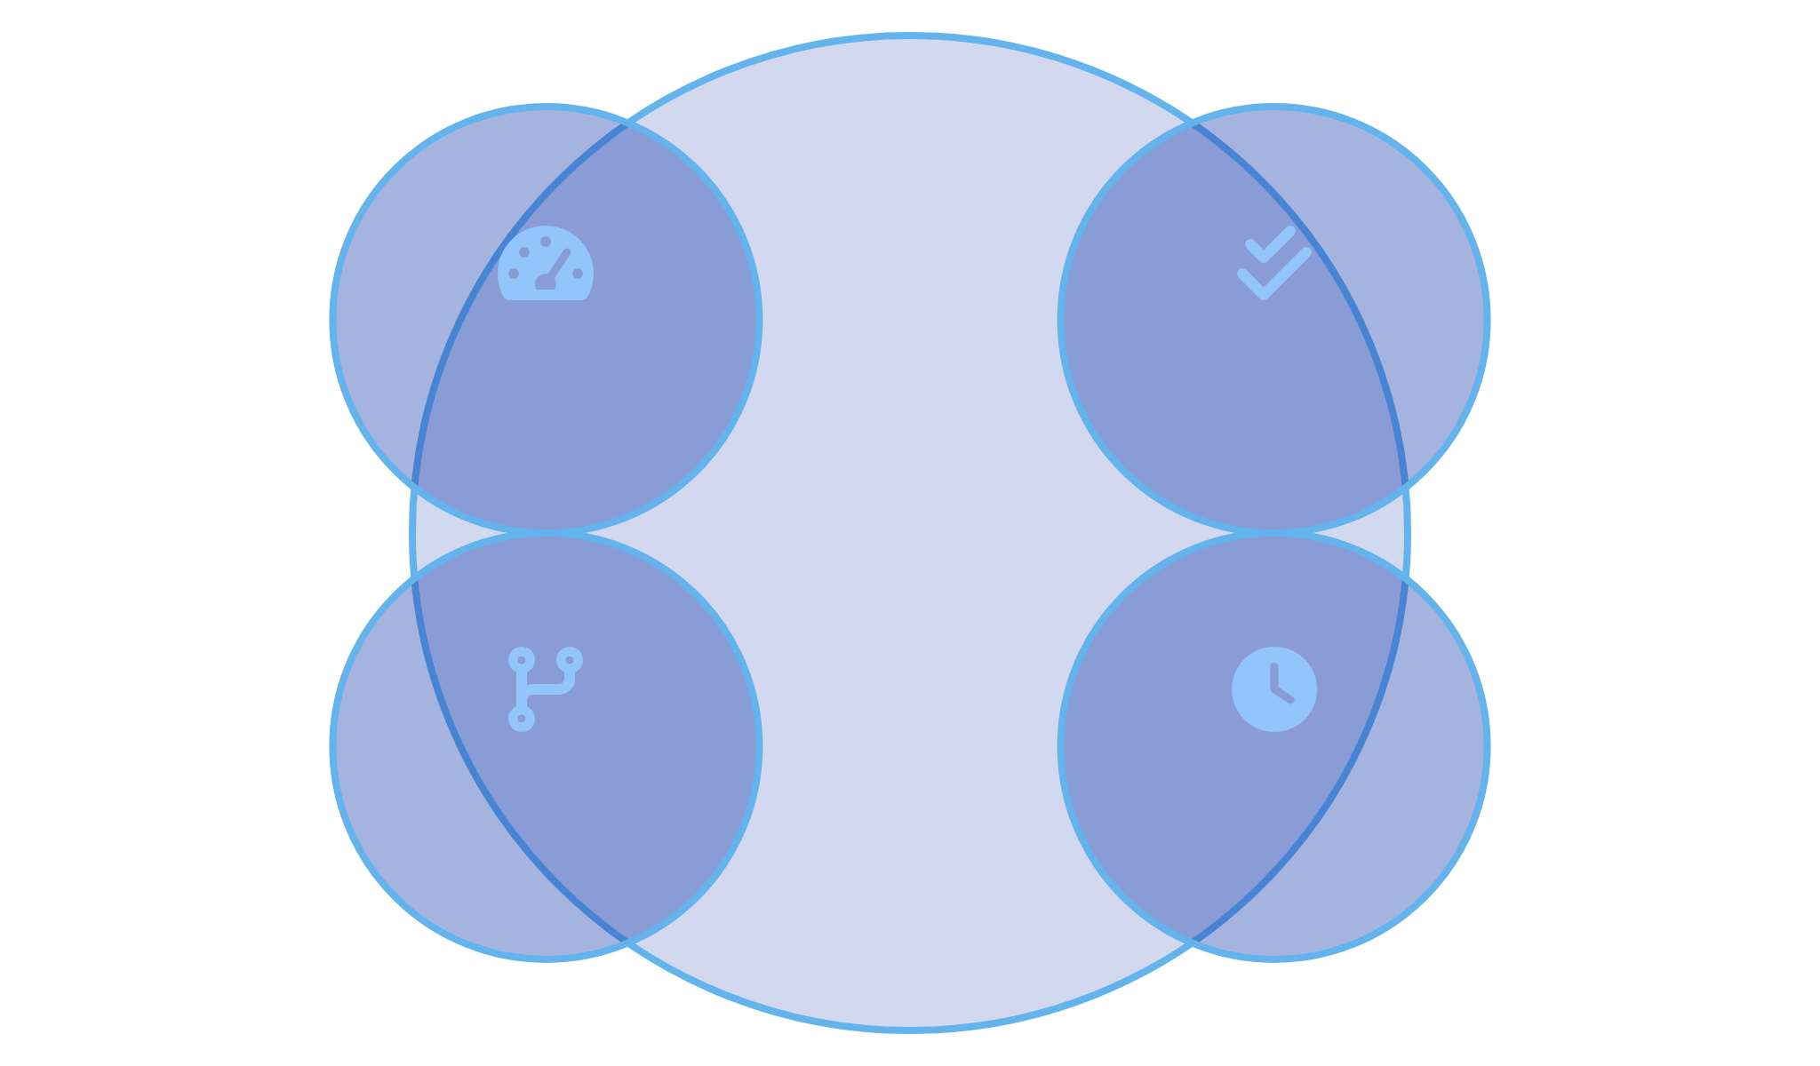










Importance of
Dry Run
Why Dry Run Matters
Professional Applications
Deeper Understanding
Technical Interviews
Manually tracing code execution helps develop a thorough understanding of how algorithms work and how different parts of the code interact with each other.
Dry running is a common requirement in technical interviews to demonstrate understanding of algorithms and problem-solving approach.
"Show me how this algorithm works with input [1, 3, 5, 7]"
Error Detection
Dry running helps identify logical errors, edge cases, and potential bugs before the code is executed on a computer, saving debugging time.
Code Reviews
Helps reviewers understand and validate complex logic without having to run the code, especially for critical sections.
Algorithm Verification
Confirms that an algorithm produces the expected output for various inputs and follows the intended logic path.
Documentation
Provides clear examples of how code behaves with specific inputs, enhancing documentation quality.
Educational Benefits
Efficiency Benefits
Cognitive Development
Code Comprehension
Enhances analytical thinking and problem-solving skills
Improves ability to read and understand complex code
Debugging Skills
Concept Mastery
Faster Debugging
Fewer Bugs
Develops systematic approach to finding and fixing errors
Reinforces understanding of programming concepts
Development
Efficiency
Better Design
Time Savings
Real-world Impact
Mission-Critical Systems
Team Collaboration
Computer Science Education
In aerospace, medical, and financial systems, dry running helps verify algorithm correctness before deployment where errors could be catastrophic.
Facilitates knowledge sharing and onboarding by providing clear, step-by-step explanations of how complex algorithms work.
Essential teaching tool that helps students visualize abstract concepts and understand program execution flow.
Dry running is not just a learning tool but a professional practice that separates novice programmers from experienced developers who understand code behavior at a deeper level.

Slide 8








The
Dry Run
Process
Step-by-Step Approach
Continuing the Process
1. Prepare Tracking Table
4. Record State Changes
Create a table with columns for:
Document all changes to variables and program state:
• Step number
• Variable assignments
• Line of code being executed
• Calculation results
• Variable values
• Array/object modifications
• Output (if any)
• Output generated
• Notes/observations
5. Track Program Flow
2. Initialize Variables
Note changes in execution path:
Record initial values of all variables before execution begins.
• Loop iterations
Example: For
int sum = 0; int i = 1;
, record sum=0, i=1
• Conditional branches taken
• Function entries and exits
• Early returns or breaks
3. Execute Line by Line
Follow program flow exactly as a computer would:
6. Verify Final State
• Execute one statement at a time
Check that:
• Update variable values after each operation
• Final variable values match expectations
• Follow control structures (if/else, loops)
• Return values are correct
• Track function calls and returns
• Output is as expected
• No unexpected behaviors occurred
Handling Control Structures
Dry Run Tools & Techniques
Conditionals
Loops
Evaluate condition, follow only the true branch
Check condition, execute body, update variables, repeat
Trace Tables
Memory Diagrams
Tabular format to track variables and execution steps
Visual representation of memory state and references
Function Calls
Exception Handling
Track call stack, parameters, and return values
Note when exceptions would be thrown and caught
Call Stack Diagrams
Annotated Code
Track function calls and their execution context
Write variable values directly next to code lines
For complex algorithms, combine multiple techniques to get a comprehensive understanding of program behavior.
Example Dry Run Process
Code
Dry Run Table
Step
Function
n
Return
Notes
function
factorial(n) {
if
(n <= 1) {
1
factorial(3)
3
-
Initial call
return
1;
}
2
factorial(3)
3
-
3 > 1, so recursive case
return
n * factorial(n - 1);
}
3
factorial(2)
2
-
Recursive call
// Call with n = 3
4
factorial(2)
2
-
2 > 1, so recursive case
factorial(3);
5
factorial(1)
1
-
Recursive call
6
factorial(1)
1
1
Base case reached
7
factorial(2)
2
2
Return 2 * 1 = 2
8
factorial(3)
3
6
Return 3 * 2 = 6

Slide 9

Dry Run
Examples: Simple Programs
Example 1: Simple Loop
Example 2: Conditional Logic
Code
Code
function
sumEven(n) {
function
findGrade(score) {
let
sum = 0;
let
grade;
for
(
let
i = 2; i <= n; i += 2) {
if
(score >= 90) {
sum += i;
grade = 'A';
}
}
else if
(score >= 80) {
return
sum;
grade = 'B';
}
}
else if
(score >= 70) {
grade = 'C';
// Call with n = 6
}
else if
(score >= 60) {
grade = 'D';
}
else
{
grade = 'F';
Dry Run Table
}
Step
Line
i
sum
Notes
return
grade;
}
1
1
-
-
Function called with n=6
2
2
-
0
Initialize sum
// Call with score = 85
3
3
2
0
Initialize loop with i=2
4
4
2
2
sum += 2
Dry Run Table
5
3
4
2
Increment i to 4
Step
Line
score
grade
Condition
Notes
6
4
4
6
sum += 4
1
1
85
-
-
Function called with score=85
7
3
6
6
Increment i to 6
8
4
6
12
sum += 6
2
2
85
undefined
-
Declare grade variable
9
3
8
12
Increment i to 8, exit loop
3
3
85
undefined
85 >= 90
False, skip this block
10
6
8
12
Return sum = 12
4
5
85
undefined
85 >= 80
True, enter this block
5
6
85
'B'
-
Assign grade = 'B'
6
14
85
'B'
-
Skip remaining conditions
7
15
85
'B'
-
Return grade = 'B'
Example 3: Array Manipulation
Code
Dry Run Table
Step
Line
i
arr[i]
result
Notes
function
reverseArray(arr) {
1
1
-
-
-
Function called with [1,2,3]
const
result = [];
for
(
let
i = arr.length - 1; i >= 0; i--) {
2
2
-
-
[]
Initialize empty result array
result.push(arr[i]);
3
3
2
3
[]
Initialize loop with i=2
}
return
result;
4
4
2
3
[3]
Push arr[2] to result
}
5
3
1
2
[3]
Decrement i to 1
// Call with arr = [1, 2, 3]
6
4
1
2
[3,2]
Push arr[1] to result
7
3
0
1
[3,2]
Decrement i to 0
Visualization
8
4
0
1
[3,2,1]
Push arr[0] to result
Input Array
9
3
-1
-
[3,2,1]
Decrement i to -1, exit loop
1
2
3
10
6
-1
-
[3,2,1]
Return result = [3,2,1]
0
1
2
Result Array Building
Key Insights from Dry Run
i = 2:
3
• Dry running helps visualize array operations step by step
• Tracking loop variables and array indices prevents off-by-one errors
i = 1:
3
2
• Helps understand how arrays are built or modified during execution
• Reveals the exact sequence of operations in array manipulations
i = 0:
3
2
1

Slide 10

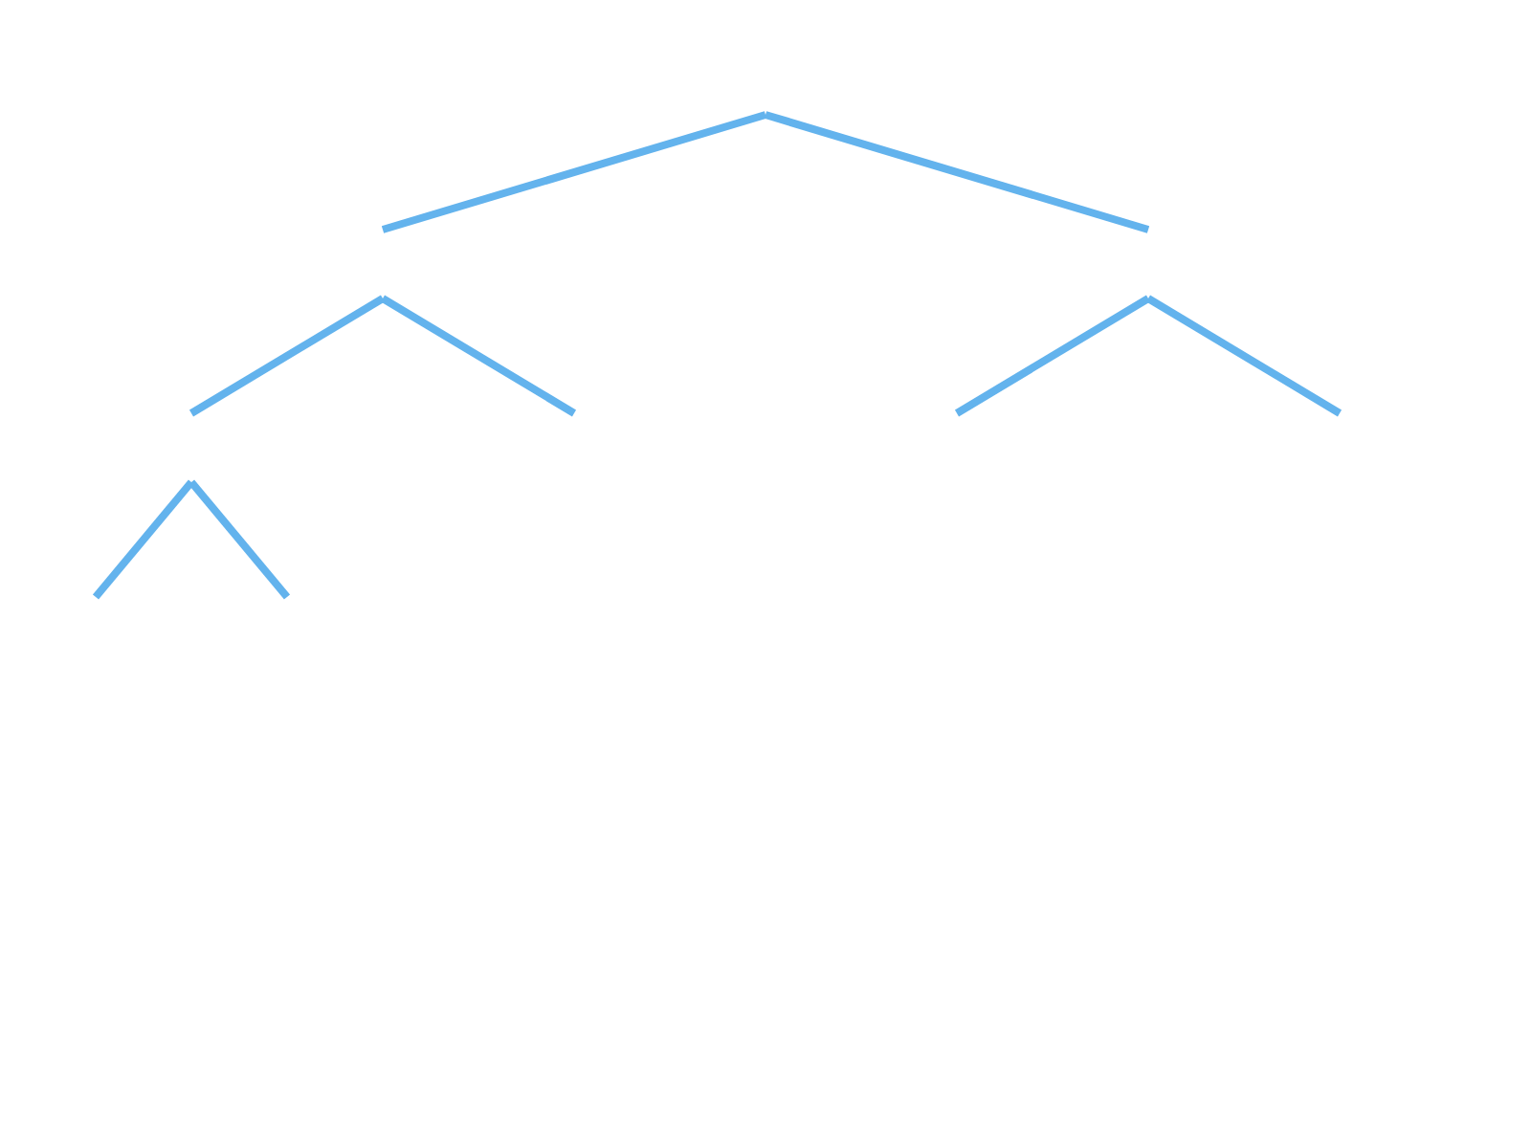
Dry Run
Examples: Complex Scenarios
Example 1: Nested Loops
Example 2: Recursive Function
Code
Code
function
multiplicationTable(n) {
function
fibonacci(n) {
let
result = [];
// Base cases
for
(
let
i = 1; i <= n; i++) {
if
(n <= 0)
return
0;
let
row = [];
if
(n === 1)
return
1;
for
(
let
j = 1; j <= n; j++) {
row.push(i * j);
// Recursive case
}
return
fibonacci(n - 1) + fibonacci(n - 2);
result.push(row);
}
}
return
result;
// Call with n = 4
}
// Call with n = 3
Dry Run Approach for Recursion
For recursive functions, track the call stack and return values:
Dry Run Approach
1. Draw a tree to visualize recursive calls
For nested loops, track both loop variables and maintain a clear view of the nested structure:
2. Track function parameters for each call
3. Follow execution in depth-first order
1. Create a table with columns for both loop variables (i, j)
4. Record return values as they propagate back up
2. Track the inner array (row) and outer array (result) separately
3. Follow the complete execution of the inner loop for each iteration of the outer loop
Tip: Use indentation or a tree diagram to represent the call stack depth and relationships between recursive calls.
4. Pay special attention to when arrays are created, modified, and added to other arrays
Tip: For complex nested structures, use indentation in your tracking table to visually represent the nesting level.
Recursive Call Tree
fib(4)
= 3
Nested Loop Execution Visualization
fib(3)
fib(2)
= 2
= 1
i
j
i * j
row
result
fib(2)
fib(1)
fib(1)
fib(0)
= 1
= 1
= 1
1
1
1
[1]
[]
= 0
1
2
2
[1,2]
[]
fib(1)
fib(0)
= 1
1
3
3
[1,2,3]
[]
= 0
1
-
-
[1,2,3]
[[1,2,3]]
2
1
2
[2]
[[1,2,3]]
2
2
4
[2,4]
[[1,2,3]]
Recursive call tree for fibonacci(4)
2
3
6
[2,4,6]
[[1,2,3]]
2
-
-
[2,4,6]
[[1,2,3],[2,4,6]]
Key Insights for Complex Dry Runs
3
1
3
[3]
[[1,2,3],[2,4,6]]
• Use appropriate visualization techniques for different algorithm types
3
2
6
[3,6]
[[1,2,3],[2,4,6]]
• For recursion, track the call stack and return values carefully
• For nested loops, maintain clear separation between iterations
3
3
9
[3,6,9]
[[1,2,3],[2,4,6]]
• Document intermediate states to catch subtle bugs
3
-
-
[3,6,9]
[[1,2,3],[2,4,6],[3,6,9]]
• Pay special attention to boundary conditions and edge cases
Final return value: [[1,2,3], [2,4,6], [3,6,9]]
Example 3: Multi-Condition Logic
Code
Dry Run Table
Step
Line
Condition
isValid
errors
function
validatePassword(password) {
1
1
-
-
-
let
isValid = true;
let
errors = [];
2
2-3
-
true
[]
// Check length
3
6
Pass123.length < 8
true
[]
if
(password.length < 8) {
4
11
!/[A-Z]/.test("Pass123")
true
[]
isValid = false;
errors.push("Too short");
5
17
!/[0-9]/.test("Pass123")
true
[]
}
6
22-26
-
true
[]
// Check for uppercase
if
(!/[A-Z]/.test(password)) {
Return value: { isValid: true, errors: [] }
isValid = false;
Testing with Different Input
errors.push("No uppercase");
}
For "pass" input:
// Check for number
• Length check: fails (length = 4 < 8)
if
(!/[0-9]/.test(password)) {
• Uppercase check: fails (no uppercase)
isValid = false;
• Number check: fails (no number)
errors.push("No number");
• Result: { isValid: false, errors: ["Too short", "No uppercase", "No number"] }
}
return
{
isValid: isValid,
errors: errors
};
}
// Call with "Pass123"

Slide 11






Introduction to
Flagged While Loops
What is a Flagged While Loop?
When to Use Flagged While Loops
A flagged while loop is a control structure that uses a boolean variable (flag) to control the execution of a loop based on conditions that may change during loop execution.
Search Operations
When searching for an element in a collection and need to exit once found.
Example: Searching for a specific value in an array or linked list
boolean
flag = true;
// Initialize flag
User Input Validation
while
(flag) {
// Loop continues as long as flag is true
When repeatedly prompting for input until valid data is received.
// Loop body
// Some condition to modify the flag
Example: Asking for a number within a specific range
if
(someCondition) {
flag = false;
// Change flag to exit loop
}
Menu-Driven Programs
}
When displaying a menu repeatedly until the user chooses to exit.
Example: Console application with multiple options
Unlike traditional loops with fixed conditions, flagged while loops allow for dynamic exit conditions that can be triggered from anywhere within the loop body.
Complex Termination Logic
When loop termination depends on multiple conditions or events.
Example: Game loop that ends on win, loss, or user quit
Key Characteristics
Boolean Flag
Dynamic Control
Simple Example
Uses a boolean variable to control loop execution
Exit condition can change based on runtime events
// Search for a target value in an array
public static boolean
target) {
findValue(
int
[] array,
int
Multiple Exit Points
Flexible Iteration
Can exit from different locations in the loop body
Number of iterations determined at runtime
boolean
found = false;
int
i = 0;
while
(!found && i < array.length) {
Common Flag Names
if
(array[i] == target) {
found = true;
// Set flag to exit loop
}
else
{
running
found
done
i++;
}
valid
continue
exit
}
return
found;
}
Execution Flow
Exit (found=true)
Start
Check
Found?
End
Advantages and Considerations
Advantages
Considerations
Provides flexibility for complex termination conditions
Requires careful flag management to avoid infinite loops
Allows for clearer expression of certain algorithms
May introduce additional state variables (flags)
Can simplify loops with multiple exit conditions
Can be less readable if flag logic is complex
Makes the termination condition explicit and readable
Sometimes alternatives like break/continue are clearer
Useful for event-driven or user-input scenarios
May need additional variables for tracking loop state
Flagged while loops are particularly valuable when the loop termination condition depends on events that occur within the loop body rather than a predetermined number of iterations or a simple condition that can be checked at the start of each iteration.

Slide 12






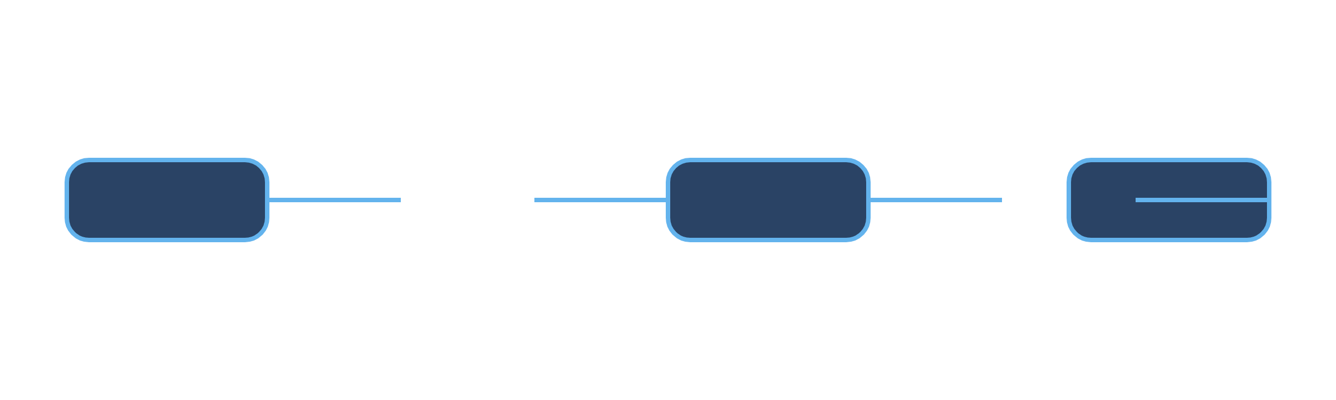
Structure of
Flagged While Loops
Basic Structure
Common Structural Patterns
// 1. Flag initialization
1. Basic Search Pattern
boolean
flag = true;
// or false depending on logic
// 2. Loop condition using flag
boolean
found = false;
while
(flag) {
int
i = 0;
while
(!found && i < array.length) {
// 3. Loop body
if
(array[i] == target) {
// Process, calculate, or perform operations
found = true;
}
else
{
i++;
// 4. Flag modification based on conditions
}
if
(someCondition) {
}
flag = false;
// Change flag to exit loop
// found will be true if target was found
}
// i will be the index where it was found
// 5. Optional: Additional processing
}
2. Input Validation Pattern
// 6. Code after loop exits
boolean
validInput = false;
String
input;
The flag variable acts as a switch that can be flipped at any point within the loop body to control when the loop should terminate.
while
(!validInput) {
input = getUserInput();
if
(isValid(input)) {
validInput = true;
}
else
{
displayErrorMessage();
}
}
Flag Initialization Patterns
// Process valid input
True-to-False Pattern
False-to-True Pattern
3. Menu-Driven Pattern
boolean
running = true;
boolean
found = false;
while
(running) {
while
(!found) {
boolean
running = true;
// Loop body
// Loop body
if
(exitCondition) {
if
(searchCondition) {
while
(running) {
running = false;
found = true;
displayMenu();
}
}
int
choice = getUserChoice();
}
}
switch
(choice) {
Use when: Loop should run until a specific condition is met
Use when: Searching for something or waiting for a condition to become true
case
1:
option1();
break
;
case
2:
option2();
break
Combined Flag Patterns
;
case
0:
running = false;
// Exit option
boolean
running = true;
break
;
boolean
found = false;
}
while
(running && !found) {
}
// Loop body
if
(searchCondition) {
found = true;
}
if
(errorCondition) {
running = false;
}
Flag Modification Strategies
}
Use when: Multiple exit conditions are needed (success, error, timeout, etc.)
Direct Assignment
Toggle
if
(condition) {
if
(condition) {
flag = false;
flag = !flag;
}
}
Simple and clear approach
Useful for alternating states
Conditional Assignment
Method-Based
flag = condition ? true : false;
flag = checkCondition();
Encapsulates complex flag logic in a method
Compact way to set flag based on condition
Be careful with flag modifications! Always ensure that there is at least one path through the loop that will modify the flag, otherwise you risk creating an infinite loop.
Combining Flags with Other Conditions
Flag + Counter
Multiple Flags
Flag + Time Limit
boolean
found = false;
boolean
dataValid = false;
boolean
running = true;
int
count = 0;
boolean
hasPermission = false;
long
startTime = System.currentTimeMillis();
int
maxAttempts = 5;
while
(!dataValid || !hasPermission) {
long
timeLimit = 10000;
// 10 seconds
while
(!found && count < maxAttempts) {
if
(!dataValid) {
// Loop body
dataValid = validateData();
while
(running &&
count++;
}
(System.currentTimeMillis() - startTime < timeLimit)) {
}
if
(!hasPermission) {
// Loop body
Useful for limiting attempts or iterations
hasPermission = checkPermission();
}
}
}
For operations that need a timeout mechanism
For complex conditions with multiple requirements
Execution Flow Diagram
Continue Loop
Initialize Flag
Check Flag
Loop Body
Modify Flag?
Exit Loop

Slide 13







Flagged While Loop
Examples
Example 1: User Input Validation
Example 3: Menu-Driven Application
Problem
Problem
Create a program that asks the user for a number between 1 and 100, and keeps asking until a valid number is entered.
Create a simple calculator application with a menu that allows users to perform operations until they choose to exit.
import
java.util.Scanner;
import
java.util.Scanner;
public class
InputValidator {
public class
MenuCalculator {
public static void
main(String[] args) {
public static void
main(String[] args) {
Scanner scanner =
new
Scanner(System.in);
Scanner scanner =
new
Scanner(System.in);
boolean
validInput = false;
boolean
running = true;
int
number = 0;
while
(running) {
while
(!validInput) {
System.out.println("\nCalculator Menu:");
System.out.print("Enter a number between 1 and 100: ");
System.out.println("1. Add");
System.out.println("2. Subtract");
try
{
System.out.println("3. Multiply");
number = Integer.parseInt(scanner.nextLine());
System.out.println("4. Divide");
if
(number >= 1 && number <= 100) {
System.out.println("0. Exit");
validInput = true;
// Set flag to exit loop
System.out.print("Enter your choice: ");
}
else
{
System.out.println("Number must be between 1 and 100!");
int
choice = scanner.nextInt();
}
if
(choice == 0) {
}
catch
(NumberFormatException e) {
running = false;
// Set flag to exit loop
System.out.println("Invalid input! Please enter a number.");
System.out.println("Exiting calculator...");
}
else if
(choice >= 1 && choice <= 4) {
}
System.out.print("Enter first number: ");
}
double
num1 = scanner.nextDouble();
System.out.print("Enter second number: ");
System.out.println("Valid input received: " + number);
double
num2 = scanner.nextDouble();
}
switch
(choice) {
}
case
1:
System.out.println("Result: " + (num1 + num2));
break
Key Points
;
case
2:
• Flag initialized as
false
(invalid input)
System.out.println("Result: " + (num1 - num2));
• Loop continues until valid input is received
break
;
• Flag is set to
true
only when input meets all criteria
// Cases 3 and 4 omitted for brevity
• Multiple validation checks (numeric and range)
}
}
else
{
System.out.println("Invalid choice!");
}
}
Example 2: Search Algorithm
}
}
Problem
Implement a linear search algorithm to find a target value in an array and return its index (or -1 if not found).
Key Points
• Flag initialized as
true
to enter the loop
• Loop continues until user selects exit option
public static int
linearSearch(
int
[] array,
int
target) {
• Flag is set to
false
only when exit option is chosen
boolean
found = false;
• Program performs different operations based on user choice
int
index = 0;
int
result = -1;
// Default result if not found
while
(!found && index < array.length) {
if
(array[index] == target) {
Example 4: Game Loop with Multiple Exit Conditions
found = true;
// Set flag to exit loop
result = index;
// Store the found index
}
else
{
index++;
}
Problem
}
Implement a simple number guessing game that ends when the player guesses correctly, runs out of attempts, or chooses to quit.
return
result;
}
import
java.util.Scanner;
import
java.util.Random;
Execution Flow
Step
array[index]
index
found
result
public class
GuessingGame {
public static void
main(String[] args) {
Initial
-
0
false
-1
Scanner scanner =
new
Scanner(System.in);
Random random =
new
Random();
1
5
0
false
-1
2
8
1
false
-1
int
secretNumber = random.nextInt(100) + 1;
int
attempts = 0;
3
12
2
true
2
int
maxAttempts = 7;
boolean
gameRunning = true;
Final
-
2
true
2
boolean
correctGuess = false;
Example execution for array [5, 8, 12, 3, 9] with target = 12
System.out.println("Guess a number between 1 and 100");
System.out.println("You have " + maxAttempts + " attempts");
(gameRunning && attempts < maxAttempts && !correctGuess) {
while
System.out.print("Enter your guess (or 0 to quit): ");
int
guess = scanner.nextInt();
if
(guess == 0) {
gameRunning = false;
// User quits
System.out.println("Game over. The number was " + secretNumber);
}
else
{
attempts++;
if
(guess == secretNumber) {
correctGuess = true;
// Correct guess
System.out.println("Congratulations! You guessed it in " + attempts + " attempts!");
}
else if
(guess < secretNumber) {
System.out.println("Too low! Attempts left: " + (maxAttempts - attempts));
}
else
{
System.out.println("Too high! Attempts left: " + (maxAttempts - attempts));
}
}
}
if
(attempts >= maxAttempts && !correctGuess) {
System.out.println("You've run out of attempts. The number was " + secretNumber);
}
}
}
Multiple Exit Conditions
Correct Guess
Max Attempts
User Quits
correctGuess = true
attempts >= maxAttempts
gameRunning = false
Real-World Applications
Database Connection Retry
File Processing
Network Communication
boolean
connected = false;
boolean
processingComplete = false;
boolean
messageReceived = false;
int
attempts = 0;
boolean
hasError = false;
boolean
timeout = false;
long
startTime = System.currentTimeMillis();
while
(!connected && attempts < MAX_RETRIES) {
while
(!processingComplete && !hasError) {
try
{
try
{
while
(!messageReceived && !timeout) {
connection = establishConnection();
Record record = readNextRecord();
Message msg = checkForMessage();
connected = true;
if
(record == null) {
}
catch
(Exception e) {
processingComplete = true;
if
(msg != null) {
attempts++;
}
else
{
messageReceived = true;
wait(RETRY_DELAY);
processRecord(record);
processMessage(msg);
}
}
}
}
}
catch
(Exception e) {
hasError = true;
(System.currentTimeMillis() - startTime > TIMEOUT_MS) {
if
Retry connecting to a database with exponential backoff
}
}
timeout = true;
}
Process records from a file until EOF or error
}
Wait for network message with timeout
Flagged while loops are particularly valuable in real-world applications where processes need to continue until specific conditions are met, with multiple potential exit paths. They provide clear control flow and make the termination logic explicit.

Slide 14

Flagged While Loops vs.
Alternatives
Alternative 1: While Loop with Break
Alternative 3: For Loop
Flagged While Loop
While Loop with Break
Flagged While Loop
For Loop
boolean
found = false;
int
i = 0;
boolean
found = false;
int
result = -1;
int
i = 0;
boolean
found = false;
int
i = 0;
int
result = -1;
for
i = 0; i < array.length; i++) {
(
int
while
(!found && i < array.length) {
while
(i < array.length) {
if
(array[i] == target) {
while
(!found && i < array.length) {
if
(array[i] == target) {
if
(array[i] == target) {
found = true;
result = i;
found = true;
// Exit loop immediately
break
;
if
(array[i] == target) {
break
;
}
else
{
found = true;
}
i++;
}
result = i;
}
}
i++;
}
else
{
}
}
i++;
// Alternative without break:
}
for
i = 0; i < array.length && result == -1; i++) {
(
int
if
(found) {
if
(found) {
}
System.out.println("Found at: " + i);
System.out.println("Found at: " + i);
if
(array[i] == target) {
}
}
result = i;
}
}
Comparison
Flagged While Loop
While Loop with Break
Comparison
• Condition check at loop start
• Immediate exit when condition met
Flagged While Loop
For Loop
• Flag state visible throughout loop
• Potentially more efficient
• More explicit control flow
• More concise for simple iterations
• Multiple exit conditions combined
• Can be harder to follow with multiple breaks
• Flag makes search status clear
• Clearer when iteration count is known
• No abrupt flow interruption
• Better for complex termination logic
• Scope of counter variable is limited
• Interrupts normal flow control
• More flexible for dynamic conditions
• Standard pattern for array traversal
Alternative 2: Do-While Loop
Alternative 4: Recursive Approach
Flagged While Loop
Do-While Loop
Flagged While Loop
Recursive Approach
boolean
validInput = false;
int
number = 0;
int
number = 0;
boolean
validInput;
public static int
public static int
search(
int
[] array,
int
search(
int
[] array,
int
while
(!validInput) {
do
{
target) {
target) {
System.out.print("Enter a number: ");
validInput = true;
// Assume valid
boolean
found = false;
searchHelper(array, target, 0);
return
int
i = 0;
try
{
System.out.print("Enter a number: ");
}
number = scanner.nextInt();
(!found && i < array.length) {
while
try
{
private static int
validInput = true;
number = scanner.nextInt();
if
(array[i] == target) {
searchHelper(
int
[] array,
int
}
catch
(Exception e) {
found = true;
target,
int
index) {
System.out.println("Invalid input!");
}
catch
(Exception e) {
}
else
{
// Base case: end of array
System.out.println("Invalid input!");
i++;
(index >= array.length) {
if
scanner.nextLine();
// Clear buffer
}
scanner.nextLine();
// Clear buffer
}
return
-1;
}
}
}
validInput = false;
return
found ? i : -1;
}
}
// Base case: found target
}
while
(!validInput);
(array[index] == target) {
if
return
index;
Comparison
}
// Recursive case
searchHelper(array, target, index + 1);
Flagged While Loop
Do-While Loop
return
• Flag initialized before loop
• Always executes at least once
}
• Condition checked before first iteration
• Condition checked at end of loop
• Flag can be modified anywhere in loop
• Better when first iteration must run
• Consistent with other loop patterns
• Can be more concise for input validation
Comparison
Flagged While Loop
Recursive Approach
• Iterative approach with explicit state
• More elegant for certain problems
• More memory efficient
• State managed through parameters
• No risk of stack overflow
• No explicit flags needed
• Often more intuitive for simple problems
• Better for tree/graph traversals
When to Choose Each Approach
Choose Flagged While Loop When:
Choose Do-While Loop When:
You need multiple exit conditions that are checked at the start of each iteration
You need to execute the loop body at least once
The exit condition can only be determined after first execution
The loop's termination logic is complex and depends on multiple factors
You're implementing input validation that requires at least one attempt
The condition check logically belongs at the end of the loop
You need to track the state of the search or process explicitly
You want to avoid using break/continue statements for better readability
Choose Recursive Approach When:
The loop's exit condition may change dynamically during execution
The problem naturally breaks down into smaller instances of itself
You're working with hierarchical data structures (trees, graphs)
Choose For Loop When:
The solution is more elegant and readable with recursion
You're iterating through a collection with a known size
The recursion depth is limited and stack overflow is not a concern
The number of iterations is predetermined or fixed
You want to limit the scope of the counter variable
The loop follows a standard increment pattern
The best approach depends on the specific problem requirements, readability concerns, and performance considerations. Often, multiple approaches can solve the same problem effectively, so choose the one that makes your code most maintainable and understandable in your specific context.

Slide 15







Best Practices and
Common Pitfalls
Logic Building Best Practices
Flagged While Loop Best Practices
Understand the Problem First
Clear Flag Initialization
Clearly define inputs, outputs, and constraints
DO:
DON'T:
Break down complex problems into smaller, manageable parts
Consider edge cases and boundary conditions
// Clear purpose
// Unclear purpose
boolean
found = false;
boolean
flag = true;
boolean
hasErrors = false;
boolean
f = false;
Plan Before Coding
Use pseudocode to outline your solution
Draw flowcharts for complex logic flows
Meaningful Flag Names
Consider multiple approaches before implementation
DO:
DON'T:
boolean
Start Simple, Then Refine
isValidInput = false;
boolean
check = false;
boolean
temp = true;
Begin with a working solution, even if inefficient
boolean
connectionEstablished = true;
Incrementally improve and optimize
Test each improvement separately
Ensure Flag Modification
Dry Run Best Practices
DO:
DON'T:
while
(!found) {
while
(!found) {
Be Systematic
if
(condition) {
if
(condition) {
found = true;
// No flag update path!
Create a table to track variables and their values
}
// Always update counter or state
doSomething();
Follow code execution line by line
}
Document each state change clearly
i++;
}
}
Use Multiple Test Cases
Test with normal, boundary, and edge cases
Include invalid inputs to test error handling
Common Pitfalls to Avoid
Consider minimum and maximum values
Pay Special Attention To
Logic Building Pitfalls
Loop entry and exit conditions
Jumping straight to coding without understanding the problem
Conditional branches and their outcomes
Overlooking edge cases and boundary conditions
Array indices and boundary checks
Creating overly complex solutions for simple problems
Variable initialization and updates
Not considering algorithm efficiency and scalability
Dry Run Pitfalls
Skipping steps or making assumptions
Not tracking all variable changes accurately
Testing only with "happy path" inputs
Overlooking off-by-one errors in loops and arrays
Flagged While Loop Pitfalls
Creating infinite loops by not updating flags
Using unclear or ambiguous flag names
Overcomplicating conditions with too many flags
Modifying flags in multiple places without clear logic
Debugging and Troubleshooting Tips
Logic Errors
Loop Issues
Conditional Logic
Verify your algorithm with simple test cases first
Check loop initialization, condition, and update steps
Check for correct boolean operators (&&, ||)
Check boundary conditions (first/last elements, empty collections)
Verify comparison operators (==, !=, <, >, <=, >=)
Verify that flags are properly updated within the loop
Test each branch of complex conditions separately
Trace variable values at key points in execution
Consider De Morgan's laws for simplifying complex conditions
Verify that your solution handles all required cases
Look for off-by-one errors in array indices
Ensure loop termination conditions are reachable
Systematic Debugging Process
Identify Issue
Reproduce with Simple Case
Trace Execution
Fix and Verify
Test
Remember that mastering logic building, dry run techniques, and loop constructs takes practice. Don't be discouraged by initial challenges. The ability to think algorithmically and trace code execution are skills that improve with consistent practice and application.

Slide 16


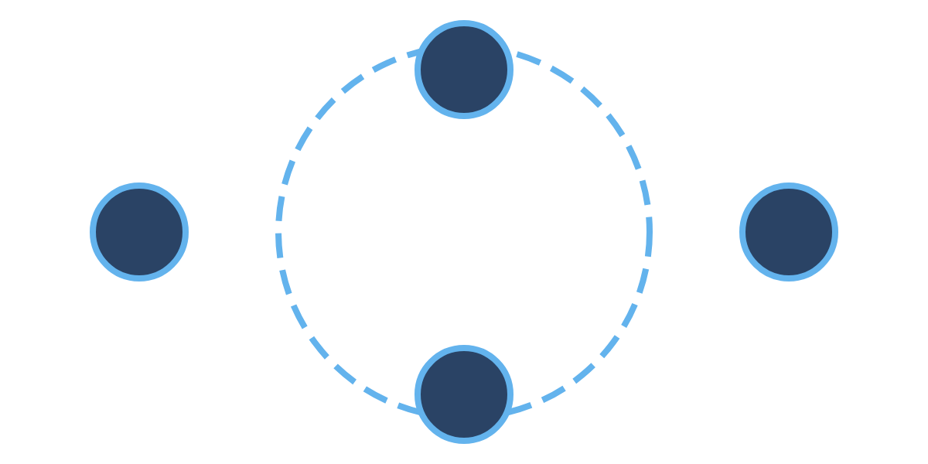



Summary and
Key Takeaways
Logic Building
Flagged While Loops
Key Concepts
Key Concepts
Logic building is the process of developing step-by-step solutions to programming problems
Flagged while loops use boolean variables to control loop execution based on specific conditions
Effective logic building requires understanding the problem, breaking it down, and planning before coding
Essential components include flag initialization, loop condition using the flag, and flag modification
Techniques include flowcharts, pseudocode, stepwise refinement, and pattern recognition
Common patterns: search operations, input validation, menu-driven programs, and complex termination logic
Always understand the problem completely before attempting to solve it
Use meaningful flag names and ensure there's always a path to modify the flag
Start with simple solutions and incrementally refine them
Choose the appropriate loop structure based on the specific problem requirements
Dry Run Techniques
Integrated Approach
Key Concepts
Dry run is a manual tracing of code execution to understand program flow and identify errors
Combining All Three Skills
The most effective programmers integrate logic building, dry run techniques, and appropriate control structures:
Essential for debugging, understanding algorithms, and preparing for technical interviews
Build logic by understanding the problem and planning the solution
Involves tracking variables, following control flow, and documenting state changes
Implement the solution using appropriate control structures like flagged while loops
Create tables to systematically track variable values during execution
Verify correctness through systematic dry runs
Refine and optimize based on insights gained
Test with normal, boundary, and edge cases to ensure comprehensive understanding
Continuous Improvement Cycle
Plan
Refine
Implement
Test
Final Thoughts
Think First, Code Later
Choose the Right Tool
Practice Deliberately
Invest time in understanding problems and planning solutions before writing code. This approach leads to cleaner, more efficient, and more maintainable solutions.
Select the appropriate control structures and algorithms based on the specific requirements of each problem. There's rarely a one-size-fits-all solution in programming.
Regularly practice logic building and dry run techniques with increasingly complex problems. Deliberate practice is the key to mastering these fundamental programming skills.
"Programming is not about typing, it's about thinking." — The key to becoming a proficient programmer lies not in memorizing syntax, but in developing strong logical thinking and problem-solving skills.
Remember: Logic building, dry run techniques, and understanding control structures are foundational skills that will serve you throughout your programming journey.

Slide 17










Questions &
Answers
Common Questions
More Questions
Q: When should I use a flagged while loop instead of a for loop?
Q: How can I improve my logic building skills?
A: Practice regularly with diverse problems. Start with simple problems and gradually increase complexity. Break down problems into smaller parts. Study algorithms and data structures. Review and analyze others' solutions. Participate in coding challenges and competitions.
A: Use flagged while loops when you need dynamic exit conditions that may change during execution, or when the number of iterations isn't known in advance. For loops are better when iterating a fixed number of times or through collections with known sizes.
Q: Are there tools that can help with dry runs?
Q: How can I avoid infinite loops when using flagged while loops?
A: Yes, many IDEs have debugging tools that let you step through code and watch variables. Online visualization tools like Python Tutor can show execution step-by-step. However, manual dry runs are still valuable for developing your understanding and for situations like technical interviews.
A: Always ensure there's at least one path in your loop that will modify the flag. Double-check that your flag modification logic is reachable and will eventually trigger. Consider adding safety mechanisms like maximum iteration counts.
Q: How do I choose between different loop structures?
Q: What's the most efficient way to perform a dry run?
A: Consider the specific requirements of your problem. Use for loops for known iteration counts, while loops for condition-based iteration, do-while loops when you need at least one execution, and flagged while loops for complex termination logic or when you need to track the state of a process explicitly.
A: Create a table with columns for each variable and rows for each step of execution. Trace through the code line by line, updating variable values in your table. Pay special attention to loops, conditionals, and function calls. Use arrows or notes to track the flow of execution.
Thank You!
Practice
Apply
Share
Regular practice is key to mastering these concepts
Apply these techniques to real-world problems
Share your knowledge and learn from others
Additional Resources
Introduction to Algorithms (CLRS)
Programming Communities
LeetCode & HackerRank
Open Source Projects
Algorithm Visualization Tools
Online Courses & Tutorials

